Slide 2
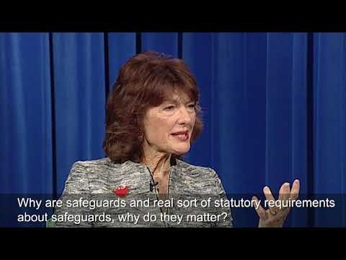

Slide 3
Safeguarding of Children and Young People – An Overview

Slide 4
Volunteer Form Requirements
Group Leaders/Representatives’ Volunteer Requirement Check List for Group Members
Group Name: _________________________________________________________________________
Group Leaders/Representative’s Name: ____________________________________________________
Date of Completion of this Check List: ______________________________________________________
Please complete this form and submit it to the Parish Office by April 30th each year.
In the event of a new member joining the group, their details are to be added and resubmitted to the parish office upon their joining.
Member’s Name, Address, Telephone Number and Email | Code of Conduct Declaration signed & submitted to the parish | Current WWC Check (registering the parish) | Police Check (where required) | Annual Induction Training completed: | Has this member retired from the group? If so on what date?

Slide 5
Child Safeguarding Risk Management Training
The Partnered Catholic Parishes of:
Sacred Heart Diamond Creek, St. Mary’s Greensborough & St. Thomas the Apostle Greensborough North

Slide 6
Documentation
Child safeguarding: Risk Management Procedure
Child safeguarding: Risk Management Form

Slide 7
What activities will this be used with?
Parish activities involving children (under 18 years of age)
Where children may be present in the area of the activity (including in private homes)

Slide 8
Purpose of the Procedure
to identify child safeguarding risks related to specific Parish-related activities
to develop risk controls
to record these and other information in a Risk Management Form

Slide 9
Definition of terms
Risk: a situation which potentially exposes a child to harm
Likelihood: the probability of a risk resulting in a child being harmed
Risk control: anything that will reduce the likelihood of a child being harmed or alarmed
Risk Management Form: a document used to list risks, risk controls etc.
Notes:
Risk – motor vehicles moving in the area of the activity, children leaving your activity, any one-on-one contact with children

Slide 10
7 Stages in the procedure
Stage 1: Decide whether child risk management is needed
Stage 2: Select the risk management team
Stage 3: Identify child safeguarding risks
Stage 4: Develop risk controls
Stage 5: Assess the (remaining) risk
Stage 6: Complete the Risk Management Form
Stage 7: Implement risk controls (mainly through training)
Notes:
I’ll now briefly address each Stage

Slide 11
Stage 1: Is risk management needed?
Does the activity involve children under 18 years of age
May children be present in the area of your activities

Slide 12
Stage 2: Select the risk management team
2 or 3 (or more) people who are involved in and familiar with the activity
Include the person responsible for the activity
If procedure used for the first time, include member of the Safeguarding Committee to give guidance
Notes:
We need the experience of working with you too

Slide 13
Risk management form

Slide 14
Stage 3: Identify the risks
A risk is a situation which potentially exposes a child to harm
Think systematically through all aspects of the activity and identify all the possible child safeguarding risks you can think of
Think through the activity from start to end and even afterwards
Look beyond the normal and consider those abnormal or infrequent occurrences that might give rise to child safeguarding risks
Try to think of situations that a paedophile might take advantage of during your activity
Refer to the checklist provided
Record the risks in Risk Management Form
Notes:
Abnormal – power failure or fire; someone you don’t know turning up unexpectantly

Slide 15
Stage 4: Develop risk controls
A risk control is anything that will reduce the likelihood of a child being harmed or alarmed
For each risk, list any existing risk controls that are currently in use
Try to think of ways of improving existing risk controls
Try to think of new risk controls
Refer to the checklist provided
Don’t include requirements of the code of conduct (unless emphasis is needed)
Record the controls in Risk Management Form (2 sections)

Slide 16
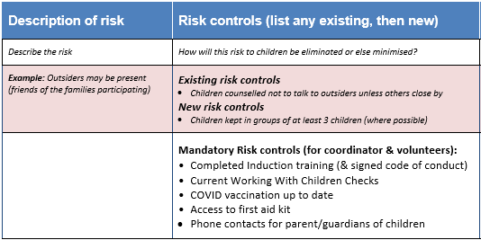
Risk management form

Slide 17
Stage 5: Assess the likelihood of risk (assuming risk controls are effective)
Likelihood scale
L – likely to be exposed to the risk
P – possibly be exposed to the risk
R – remote chance of being exposed to the risk
If your assessment of any risk is “L – likely”, further develop your risk controls. If the subsequent assessment is unchanged, seek further advice before proceeding with this activity.

Slide 18
Stage 6: Complete the Form
Add following information
For each risk, who is responsible for the risk controls?
How will risk controls be implemented and maintained?

Slide 19
Stage 7: Implement risk controls
Plan implementation and ongoing maintenance of the risk controls; assign tasks
Everyone involved in running any aspect of the activity must be trained to comply with the documented risk controls
Plan how risk controls will be monitored and their effectiveness assessed (who will do this and how it will be recorded?)
Notes:
#3 eg. brief meeting at the end of each activity

Slide 20
… and finally…
Send a copy of the completed Risk Management Form to: greensborough@cam.org.au, greensboroughnorth@cam.org.au or diamondcreek@cam.org.au

Slide 21
Questions?

Slide 22
Online Risk Assessment Workshops
Catechists Program/Children’s Liturgy – Wednesday May 4, 7.00pm – 8.30pm
Parish Events (e.g. Christmas Carols, Fetes, Working Bees – Wednesday May 18, 11.00am – 12.30am
Service & Outreach programs (e.g. visiting aged care facilities) – Thursday May 19, 11.00am – 12.30am

